Slide 1



THEORY
Training Program 1:
Advanced NLP & Large Language Models (LLMs)
M01: Text Preprocessing
M02: Word and Sentence Embeddings
M03: Transformer Architectures
M04: Entity-Centric NLP
M05:Applied NLP Tasks
M06: Multimodal NLP
M07: LLM Fundamentals
M08: Prompt Engineering
M09: Fine-Tuning & PEFT
M10: RAG & Real-World Projects

Slide 2
MODULE M01
TEXT PREPROCESSING
CHAPTER M01.1
Intro to Text Preprocessing

Slide 3
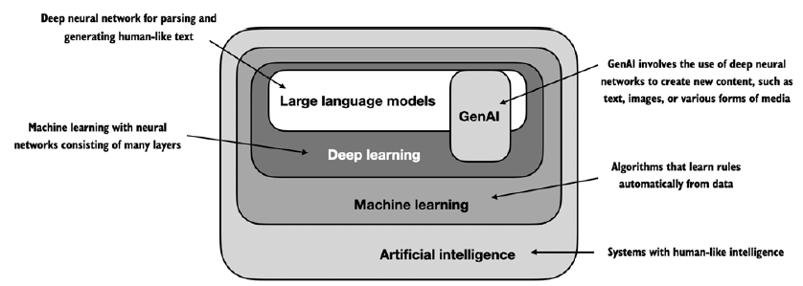
M01 TEXT PREPROCESSING
Getting started with Text Preprocessing

Slide 4
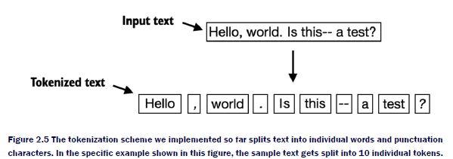
M01 TEXT PREPROCESSING
Fundamentals of tokenization
1. What is Tokenization?
2. Character vs. Word Tokenization
3. Regular Expression Tokenizers
4. Issues: Punctuation and Contractions
5. Whitespace and Rule-Based Tokenization

Slide 5
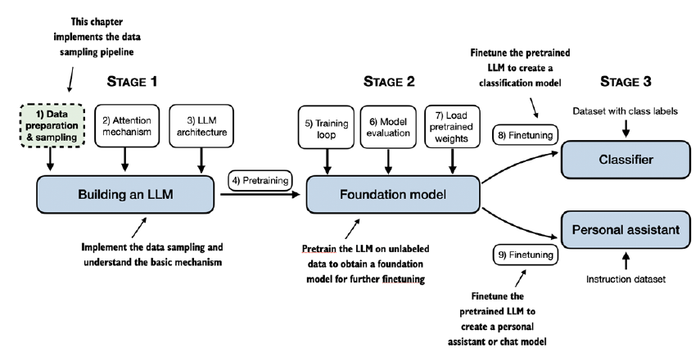
M01 TEXT PREPROCESSING
Fundamentals of tokenization

Slide 6
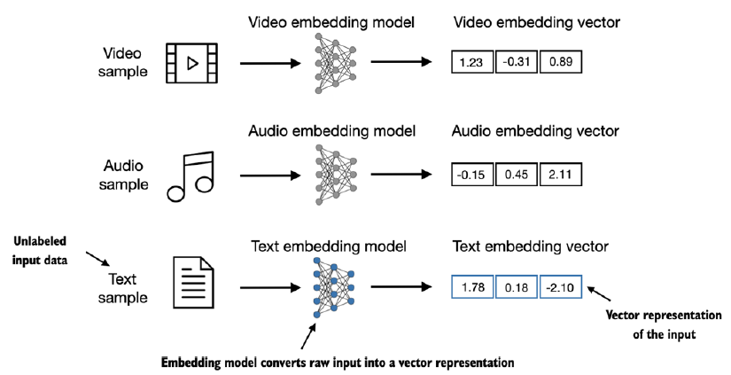
M01 TEXT PREPROCESSING
Fundamentals of tokenization

Slide 7
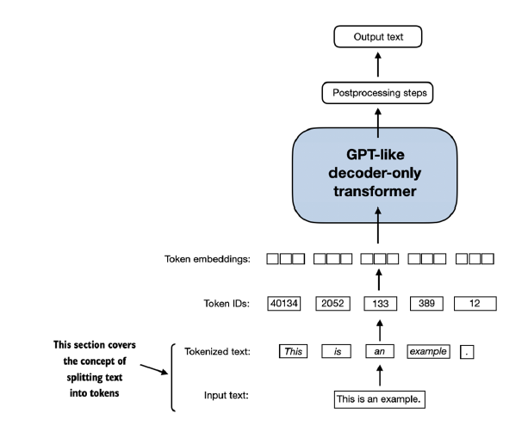
M01 TEXT PREPROCESSING
Fundamentals of tokenization

Slide 8
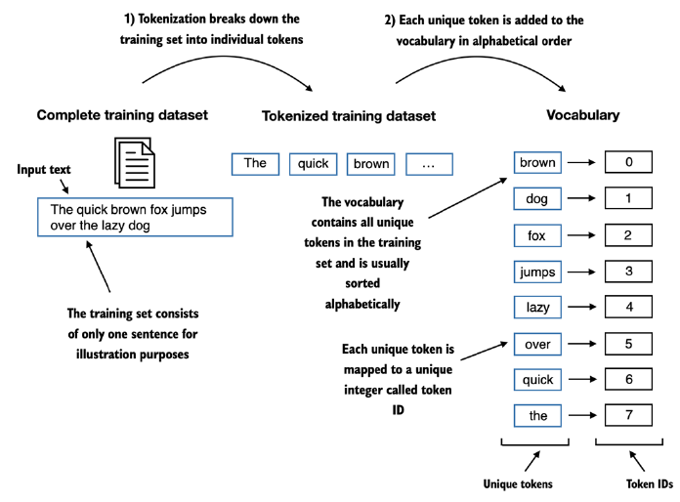
M01 TEXT PREPROCESSING
Fundamentals of tokenization

Slide 9
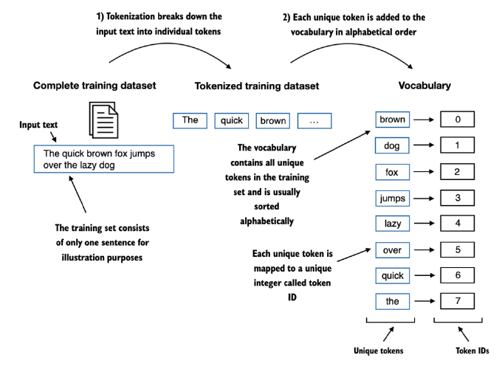
M01 TEXT PREPROCESSING
Fundamentals of tokenization

Slide 10
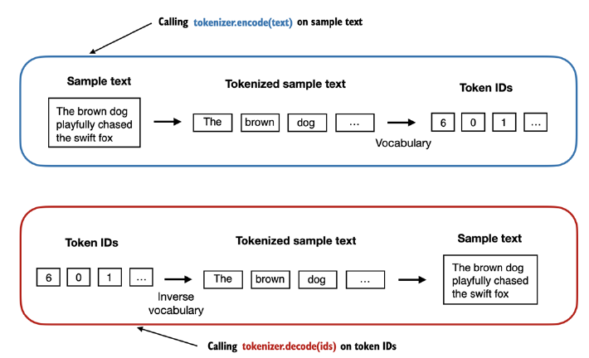
M01 TEXT PREPROCESSING
Fundamentals of tokenization

Slide 11
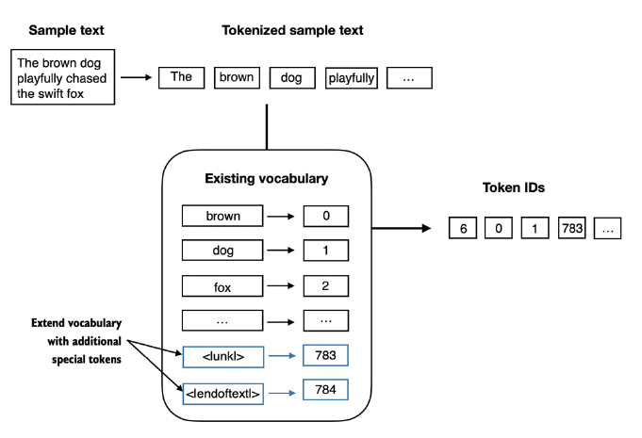
M01 TEXT PREPROCESSING
Fundamentals of tokenization

Slide 12
M01 TEXT PREPROCESSING
Byte-Pair Encoding (BPE) and Subword Tokenization
1. Introduction to Subword Tokenization
2. Why Subwords? Handling OOV (Out-of-Vocabulary)
3. The BPE Algorithm Explained
4. BPE Training Process and Vocabulary Size
5. BPE in Transformer Models (e.g., GPT)

Slide 13
M01 TEXT PREPROCESSING
Advanced Subword Tokenization with SentencePiece
1. The Need for Unsupervised Tokenization
2. SentencePiece vs. Traditional Tokenizers
3. WordPiece and Unigram Language Models
4. Key SentencePiece Features (e.g., prefixing)
5. Implementation and Use Cases

Slide 14
M01 TEXT PREPROCESSING
Stopwords and Vocabulary Management
1. Defining and Identifying Stopwords
2. Removing Stopwords: Pros and Cons
3. Contextual and Domain-Specific Stopwords
4. Alternatives to Removal: Weighting (e.g., TF-IDF)
5. Hands-on: Stopword Lists in Python

Slide 15
M01 TEXT PREPROCESSING
Processing Multilingual and Cross-Lingual Text
1. Challenges of Multilingual NLP
2. Character Sets and Encodings (e.g., UTF-8)
3. Tokenization in Different Languages
4. Cross-Lingual Transfer and Models
5. Zero-Shot and Few-Shot Multilingual Learning

Slide 16
M01 TEXT PREPROCESSING
Summary and Next Steps
Summary
Next Steps

